Slide 1
Application Protocols for IoT
Dr. Abbas Javed
Assistant Professor
Department of Electrical and Computer Engineering,
COMSATS University Islamabad, Lahore Campus
abbasjaved@cuilahore.edu.pk

Slide 2
The following categories of IoT application protocols and their transport methods are explored in the following sections:
Application layer protocol not present: In this case, the data payload is directly transported on top of the lower layers. No application layer protocol is used.
Supervisory control and data acquisition (SCADA): SCADA is one of the most common industrial protocols in the world, but it was developed long before the days of IP, and it has been adapted for IP networks.
Generic web-based protocols: Generic protocols, such as Ethernet, Wi-Fi, and 4G/LTE, are found on many consumer- and enterprise-class IoT devices that communicate over non-constrained networks.
IoT application layer protocols: IoT application layer protocols are devised to run on constrained nodes with a small compute footprint and are well adapted to the network bandwidth constraints on cellular or satellite links or constrained 6LoWPAN networks. Message Queuing Telemetry Transport (MQTT) and Constrained Application Protocol (CoAP), covered later in this chapter, are two well known examples of IoT application layer protocols.

Slide 3
The Transport Layer
Transmission Control Protocol (TCP): This connection-oriented protocol requires a session to get established between the source and destination before exchanging data. You can view it as an equivalent to a traditional telephone conversation, in which two phones must be connected and the communication link established before the parties can talk.
User Datagram Protocol (UDP): With this connectionless protocol, data can be quickly sent between source and destination—but with no guarantee of delivery. This is analogous to the traditional mail delivery system, in which a letter is mailed to a destination. Confirmation of the reception of this letter does not happen until another letter is sent in response.

Slide 4
TCP is the main protocol used at the transport layer for human interactions over the Internet.
TCP is able to transport large volumes of data into smaller sets of packets and ensures reassembly in a correct sequence, flow control, window adjustment, and retransmission of lost packets.
UDP is most often used in the context of network services or for real-time data traffic, where performance and latency are more important than packet retransmissions.
Application layer protocols take care of the function of guaranteed error-free packet reception.
When selecting a transport layer for IoT application layer protocols, the impact on both the lower and upper layers of the stack must be evaluated.

Slide 5
IoT application layer protocols
IoT application layer protocols are designed to run on constrained nodes with a small compute footprint and are well adapted to the network bandwidth constraints on cellular or satellite links or constrained 6LoWPAN networks. Two well-known examples of IoT application layer protocols are Message Queuing Telemetry Transport (MQTT) and Constrained Application Protocol (CoAP).
MQTT: MQTT is a lightweight publish/subscribe messaging protocol designed for use on limited bandwidth and unreliable networks. It is commonly used for telemetry and control applications and is supported by a wide range of IoT devices.
CoAP: CoAP is a simple protocol designed for constrained devices and networks. It is used to transfer data between devices and can operate over both UDP and TCP protocols. It is commonly used for resource-constrained devices, such as sensors and actuators.

Slide 6
Constrained IoT devices defined as class 0 send or receive only a few bytes of data
These devices do not implement a fully structured network protocol stack due to processing capability, power constraints, and cost
Class 0 devices are usually simple smart objects that are severely constrained

Slide 7
Example of Data Transport without Structured Network Stack
Low-cost temperature and relative humidity (RH) sensors send data over an LPWA LoRaWAN infrastructure
Small data payload is directly transported on top of the LoRaWAN MAC layer, without the use of TCP/IP
Lack of standardization makes it difficult for generic implementations of this transport method to be successful from an interoperability perspective

Slide 8
Standardization through IoT Data Broker
IoT data broker is a piece of middleware that standardizes sensor output into a common format that can be retrieved by authorized applications
Sensor output can be encoded differently, and the data broker can decode this data into a common, standardized format
Applications can access this temperature data without having to deal with decoding multiple temperature data formats

Slide 10
Commercial Use of IoT Data Broker
IoT data brokers are utilized from a commercial perspective to distribute and sell IoT data to third parties
Companies can provide access to their data broker from another company’s application for a fee
This makes an IoT data broker a possible revenue stream, depending on the value of the data it contains

Slide 11
Directly transporting data payload without a structured network stack optimizes data transmission over low-data-rate networks
However, lack of a data model implies that each application needs to know how to interpret the data-specific format
This becomes increasingly complex for larger networks of devices with different data payload formats, calling for structured data models and data broker applications

Slide 12
IoT Application Layer Protocols
In constrained networks or large-scale deployments of constrained nodes, verbose web-based and data model protocols may be too heavy for IoT applications.
The IoT industry is working on new lightweight protocols that are better suited to large numbers of constrained nodes and networks.
Two of the most popular protocols are CoAP and MQTT.

Slide 13
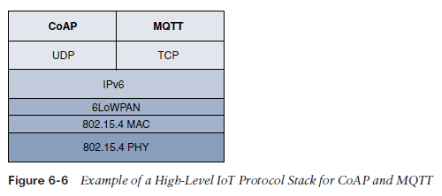

Slide 14
CoAP Protocol
Constrained Application Protocol (CoAP) is a protocol designed for constrained networks.
It is based on RESTful web services and uses the User Datagram Protocol (UDP) for transport.
CoAP is similar to HTTP, but is designed to work with low-power and lossy networks.
It is a request-response protocol and supports caching to reduce network traffic.

Slide 15
CoAP Messaging Model
Designed to facilitate the exchange of messages over UDP between endpoints
Secure transport protocol Datagram Transport Layer Security (DTLS)
Studying alternate transport mechanisms including TCP, secure TLS, and WebSocket
CoAP over Short Message Service (SMS) as defined in Open Mobile Alliance for Lightweight Machine-to-Machine (LWM2M) for IoT device management is also being considered

Slide 16
Security in CoAP
RFC 7252 provides more details on securing CoAP with DTLS
CoAP endpoint provisioned with keys and a filtering list
Four security modes: NoSec, PreSharedKey, RawPublicKey, and Certificate
NoSec and RawPublicKey implementations are mandatory

Slide 17
CoAP Message Format
Composed of a short fixed-length Header field (4 bytes), a variable-length but mandatory Token field (0–8 bytes), Options fields if necessary, and the Payload field
Figure 6-7 details the CoAP message format
Delivers low overhead while decreasing parsing complexity

Slide 18
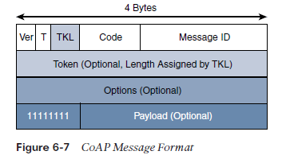

Slide 19
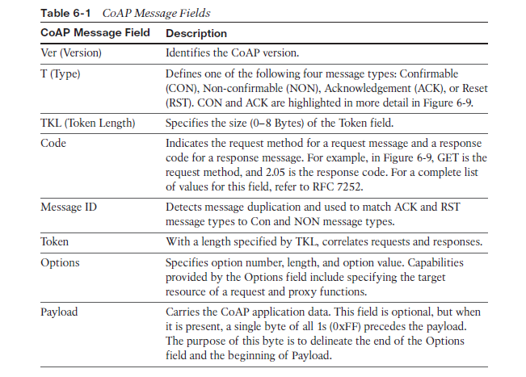

Slide 20
CoAP and IoT Communication
CoAP can run over IPv4 or IPv6
Message should fit within a single IP packet and UDP payload to avoid fragmentation
For IPv6, maximum CoAP message size could be up to 1152 bytes
For IPv4, implementations should limit themselves to more conservative values and set the IPv4 Don’t Fragment (DF) bit

Slide 21
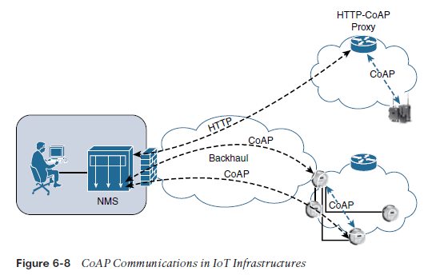

Slide 22
CoAP and IoT Communication (Contd.)
CoAP defines a pair of Block options for transferring multiple blocks of information
CoAP communications across an IoT infrastructure can take various paths
CoAP is based on the REST architecture, but with a “thing” acting as both the client and the server
CoAP defines four types of messages: confirmable, non-confirmable, acknowledgement, and reset

Slide 23
CoAP URI Format and Parameters
Example 6-2 shows the CoAP uniform resource identifier (URI) format, similar to HTTP/HTTPS
CoAP code, method and response codes, option numbers, and content format have been assigned by IANA as Constrained RESTful Environments (CoRE) parameters
The CoAP request/response semantics include the methods GET, POST, PUT, and DELETE.

Slide 24
Reliability and Congestion Control in CoAP
CoAP offers a reliable transmission of messages when a CoAP header is marked as “confirmable”
CoAP supports basic congestion control with a default time-out, simple stop and wait retransmission with exponential back-off mechanism, and detection of duplicate messages through a message ID

Slide 25
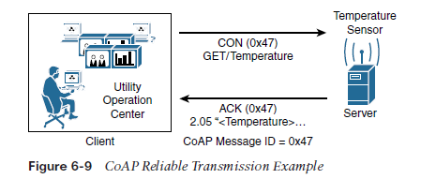

Slide 26
CoAP Example for Temperature Sensor
Figure 6-9 shows a utility operations center on the left, acting as the CoAP client, with the CoAP server being a temperature sensor on the right of the figure
CoAP Message ID ensures reliability and is used to detect duplicate messages
The client sends a GET message to get the temperature from the sensor, which is acknowledged by the sensor

Slide 27
CoAP Multicast
CoAP supports data requests sent to a group of devices by leveraging the use of IP Multicast
Implementing IP Multicast with CoAP requires the use of all-CoAP-node multicast addresses
CoAP server offering services and resources needs to be discovered by the CoAP clients

Slide 28
CoAP Service Discovery
Services from a CoAP server can be discovered by learning a URI in a namespace or through the “All CoAP nodes” multicast address
When utilizing the URI scheme for discovering services, the default port 5683 is used for non-secured CoAP, or coap, while port 5684 is utilized for DTLS-secured CoAP, or coaps

Slide 29
Message Queuing Telemetry Transport (MQTT)- Introduction
MQTT stands for Message Queuing Telemetry Transport
Developed by IBM and Arcom in the late 1990s for monitoring and controlling a large number of sensors in harsh environments
Lightweight, reliable, and cost-effective protocol
Now standardized by OASIS (Organization for the Advancement of Structured Information Standards)

Slide 30
MQTT Architecture
Client/server and publish/subscribe framework based on TCP/IP
MQTT client can act as a publisher to send data to an MQTT server acting as a message broker
The message broker handles the subscription and unsubscription process and pushes the application data to MQTT clients acting as subscribers
MQTT decouples the data transmission between publishers and subscribers
Publishers and subscribers do not have to be online at the same time

Slide 32
MQTT Wildcards and Subscriptions
Clients can subscribe to all data or specific data from the information tree of a publisher
Presence of a message broker ensures that information can be buffered and cached in case of network failures
MQTT clients can use wildcards to subscribe to all data or specific data
Subscribers express a desire to receive information from publishers

Slide 33
MQTT Control Packets
Control packets run over a TCP transport using port 1883
Optionally, MQTT can be secured using TLS on port 8883, and WebSocket can also be used
Each control packet consists of a 2-byte fixed header with optional variable header fields and optional payload
Control packet can contain a payload up to 256 MB

Slide 34
MQTT Message Format

Slide 35
MQTT Message Format
Message format overview provided in Figure 6-11
Contains a smaller header of 2 bytes compared to 4 bytes for CoAP
The first MQTT field in the header is Message Type, which identifies the kind of MQTT packet within a message
Fourteen different types of control packets are specified in MQTT version 3.1.1
MQTT header is DUP (Duplication Flag). This flag, when set, allows the client to notate that the packet has been sent previously, but an acknowledgement was not received

Slide 36
MQTT Message Types
CONNECT: Client to server request to connect
CONNACK: Server to client connect acknowledgement
PUBLISH: Client to server or server to client publish message
PUBACK: Client to server or server to client publish acknowledgement
PUBREC: Client to server or server to client publish received
PUBREL: Client to server or server to client publish release
PUBCOMP: Client to server or server to client publish complete
SUBSCRIBE: Client to server subscribe request
SUBACK: Server to client subscribe acknowledgement
UNSUBSCRIBE: Client to server unsubscribe request

Slide 38
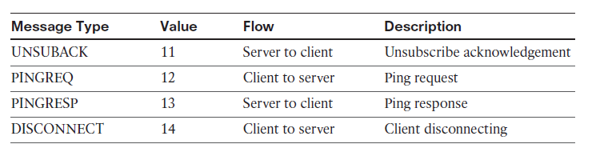

Slide 39
Three Type of QoS
QoS 0
Best-effort and unacknowledged data service
No response or retry
Message arrives once or not at all
QoS 1
Message delivery occurs at least once
Packet identifier in variable header
PUBACK packets
QoS 2
Message delivery occurs exactly once
PUBREC, PUBREL, and PUBCOMP packets
Packet identifier in variable header

Slide 40
Retain flag
Purpose of Retain flag
Found only in PUBLISH message
Notification to server to hold onto message data
MQTT sessions
Four phases of MQTT sessions i.e., session establishment, authentication, data exchange, and session termination.
Unique client ID for each client connecting to server
Delivery of application message to multiple clients
Subscriptions and unsubscriptions
SUBSCRIBE/SUBACK control packets for subscriptions
UNSUBSCRIBE/UNSUBACK control packets for unsubscriptions
DISCONNECT control packet for graceful termination of connection

Slide 41
Topic strings and topic names
How message broker uses topic string to filter messages
Hierarchical structure of topic names
Example of a topic name: adt/lora/adeunis/0018B2000000023A

Slide 42
Wildcard characters
Subscription to multiple topics using wildcard characters
Pound sign (#) matches any number of levels
Plus sign (+) matches only one topic level
Excluding topic names beginning with dollar sign ($)

Slide 43
Conclusion
MQTT is a lightweight and reliable protocol for monitoring and controlling sensors in harsh environments
MQTT uses a client/server and publish/subscribe framework based on TCP/IP
MQTT clients can subscribe to all data or specific data using wildcards
MQTT control packets consist of a 2-byte fixed header with optional variable header fields and optional payload
Fourteen different types of control packets are specified in MQTT version 3.1.1.

Slide 44
